Slide 1

Detection and Prediction of Freezing of Gait in Parkinson’s Disease
SYNOPSIS PRESENTATION
Presented By:
Aeshna Gupta
(05801032016)
Vandana Kumari
(03601032016)
Rakshita Yadav
(06701032016)
Guide:
Dr. Chandra Prakash
Assistant Professor
November 2019
IGDTUW 1

Slide 2
Introduction
FoG can be defined as a “brief, episodic absence or marked reduction of forward progression of the feet despite the intention to walk”.
Common deficit in advance Parkinson's disease.
Events are associated with:
Falls
Interfere with daily life activities
Impairs quality of life
Substantial clinical and social consequences
Resistant to pharmacological treatments.
IGDTUW 4

Slide 3
Literature Survey
Several research papers have been published on this topic.
AIM: Predict when a patient is about to experience FoG, thus enabling pre-emptive RAS, with the goal of avoiding the FoG episodes.
Most of the early research papers emphasized on Rhythmic Auditory Stimulation (RAS).
Beside FoG and normal locomotion, some papers consider the walking periods before FoG episodes as a third-class called pre-FoG, but that is beyond the scope of this project.
IGDTUW 5

Slide 4
Literature Survey
[1] proposed a wearable system, that provides rhythmic auditory signal when a FoG is detected. They also deduced that content-aware automatic cueing was more beneficial to the patients.
[4] also explored the use of smartphones as wearable device for FoG detection and treatment because of the several merits (Economical, User-Friendliness, Tele-Medicine, Social aspects) involved with it.
The algorithm presented in [4] worked much better in user-dependent environment. Therefore, patients using this system should record a set of training data for labelling FoG episodes, so that the classifier can be trained online.
IGDTUW 6

Slide 5
Limitations in other Research Papers
Even though machine learning techniques classified the FoG episodes, but the results were highly patient dependent.
Another limitation was that patient did not experience FoG during the study but reported many FoG events at home, the presence of a physiotherapist may have reduced the likelihood of FoG.
It was a controlled environment, instead of an actual daily life environment for the experiment.
IGDTUW 7

Slide 6
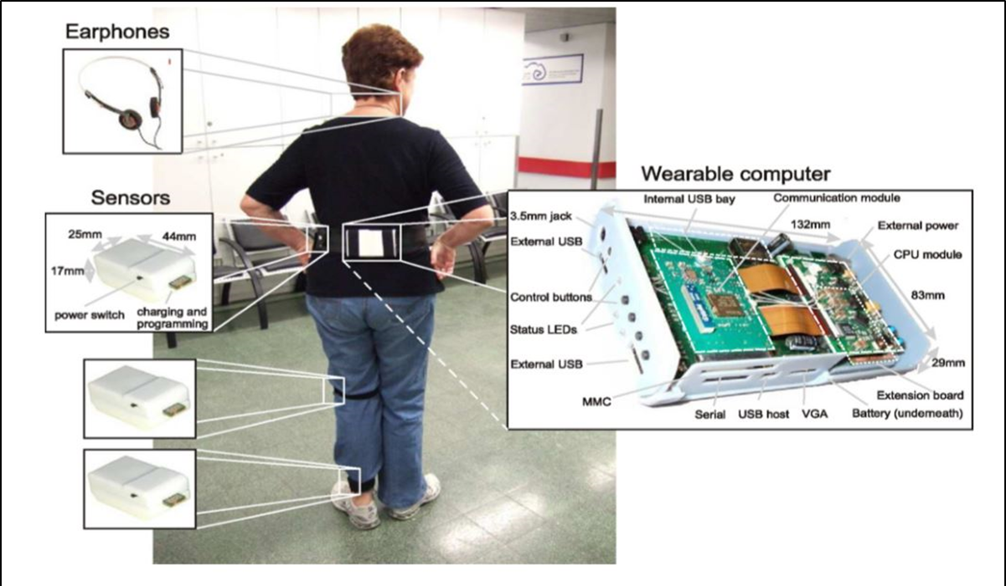
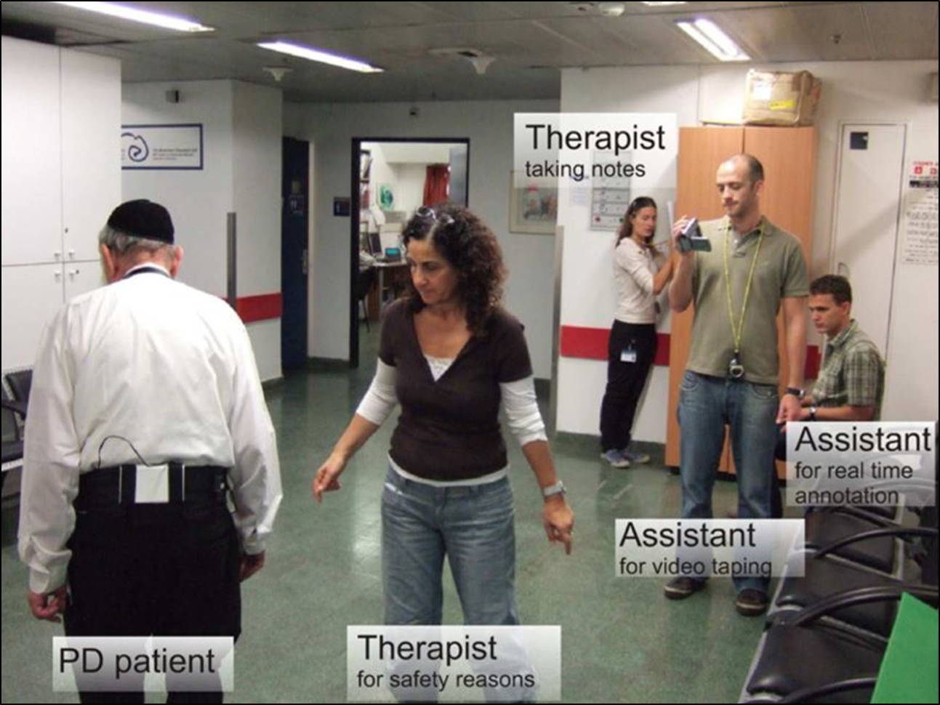
Proposed Methodology: Data set description
The DAPHnet dataset is a publicly available dataset.
Wireless accelerometer sensors placed on the ankle, thigh, and trunk of 10 PD patients.
The sensors recorded 3D accelerations at 64hz.
Users performed three kinds of tasks.
IGDTUW 8

Slide 7
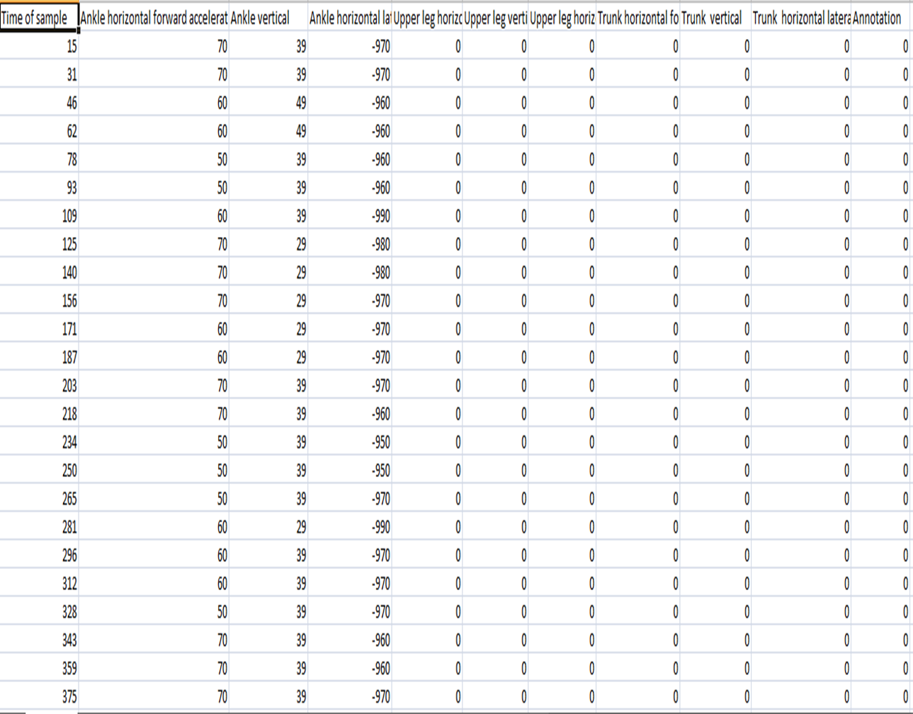
Proposed Methodology: Data description
1 for “no freeze”
2 for “freeze
There is an extra class label (annotation) in the DAPHnet dataset with the value 0.
IGDTUW 9

Slide 8
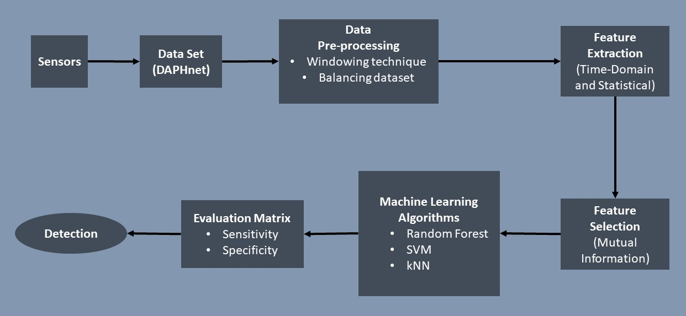
Proposed Methodology: Flow Chart
IGDTUW 10

Slide 9
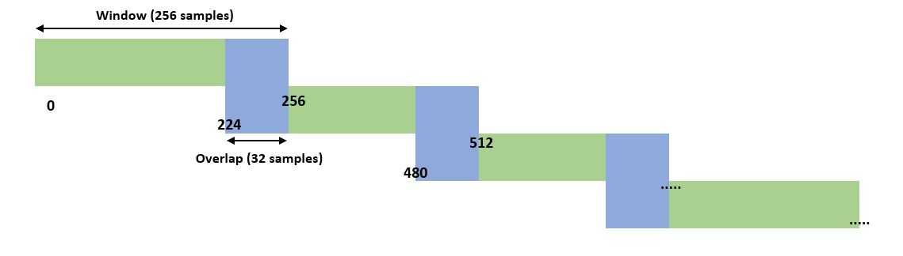
Proposed Methodology: Data Pre-processing
In our setting, we first deleted annotation 0 (not part of the experiment).
The next step: Windowing -
We used:
a window length of 4 seconds (256 samples)
an overlap of 0.5 seconds (32 samples).
Sampling frequency: 64 Hz.
A window was labeled as a FoG if more than 50% of its samples were labeled as FoG.
IGDTUW 12

Slide 10
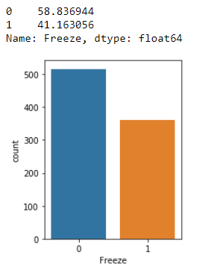
Proposed Methodology: Data Pre-processing > Balancing
Our data is unbalanced as only 5% of the data was recorded as FoG events
The remaining 95% was normal locomotion.
This happens because the model will inflate the accuracy by default.
So we needed to handle the unbalanced data.
IGDTUW 12

Slide 11
Proposed Methodology: Data Pre-processing > Balancing
Balancing techniques available:
Oversampling of minority class
Down sampling of majority class
Cost sensitive training
For our experiment we used: over sampling of minority class for better performance.
Under sampling of a majority class was NOT USED as it decreases the recall value of the majority class.
IGDTUW 12

Slide 12
Proposed Methodology: Feature Extraction
Top-ranked features from Time Domain and statistical analysis:
Mean
Variance
Standard deviation
Kurtosis
Skewness
Features were taken from:
3 locations: ankle, thigh and trunk.
3 axes: x, y &z.
Total 45 columns, for determining feature vector.
These were applied to each window, for each sensor and each axis.
IGDTUW 13

Slide 13
Proposed Methodology: Machine Learning Techniques Used
Machine Learning Techniques Used
Random Forest
Linear SVM
kNN
Tuning is done for obtaining the optimal hyperparameters based on GridSearchCV approach.
Feature Extraction Approaches
Time Domain and Statistical
IGDTUW 13

Slide 14
Evaluation
Feature vector determination: 5 features from nine acceleration signals
45 features from each signal per patient was taken into account.
If more than 50% of its samples were labeled as FoG, the window was labeled as FoG-window.
The sensitivity and specificity were noted.
IGDTUW 22

Slide 15
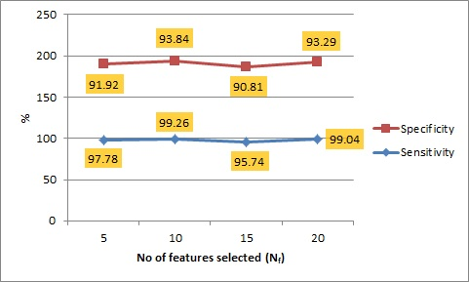
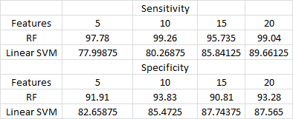
Results
These values were noted on the basis of the five features extracted.
Comparison of number of features selected
on various classifiers.
BEST: Top 20 ranked features.
Sensitivity: - 99.16%
Specificity: - 86.61%
IGDTUW 22

Slide 16
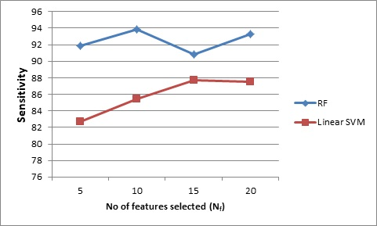
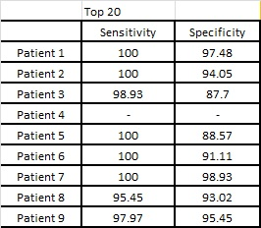
Results
Comparing different classifiers based on top 20 features
Best performance: Random Forest
Sensitivity: - 99.04%
Specificity: - 93.28%
IGDTUW 22

Slide 17
Future Work
Analyze the effect of FoG prediction on short-term and long-term periods.
Increase the performance of our system.
Recognizing the patients from their symptoms
IGDTUW 23

Slide 18
References
Wearable Assistant for Parkinson’s Disease Patients With the Freezing of Gait Symptom
(Marc B¨achlin, Meir Plotnik, Daniel Roggen, Inbal Maidan, Jeffrey M. Hausdorff, Nir Giladi, and Gerhard Tr¨oster, Senior Member, IEEE)
2. Feature Learning for Detection and Prediction of Freezing of Gait in Parkinson’s Disease
(Sinziana Mazilu1, Alberto Calatroni1, Eran Gazit2, Daniel Roggen1, Jeﬀrey M. Hausdorﬀ2, and Gerhard Tr¨oster1)
3. Online Detection of Freezing of Gait with Smartphone and Machine learning Techniques.
(Sinziana Mazilu∗ , Michael Hardegger, Zack Zhu, Daniel Roggen, Gerhard Troster)
4. A practical method for the detection of Freezing Of Gait in patients with Parkinson's Disease.
(Yuri Kwon,¹ Sang Hoon Park,¹ Ji-Won Kim,¹ Yeji Ho,¹ Hyeong-Min Jeon,¹ Min-Jung Bang,¹ Gu-In Jung,¹ Seon-Min Lee,³ Gwang-Moon Eom,^{1,2} Seong-Beom Koh,³ Jeong-Whan Lee,^{1,2} Heung Seok Jeon⁴)
IGDTUW 25

Slide 19
References
Data mining: Practical machine learning tools and techniques Witten and E. Frank, Data Mining: Practical machine learning toolsand techniques, J. Gray, Ed. Morgan Kaufmann Publishers, 2005
deFoG- a real time system for detection and unfreezing of gait of Parkinson’s patients. E. Jovanov, E. Wang, L. Verhagen, M. Fredrickson, and R. Fratangelo, ," in 31th Annual International Conference of the IEEE Engineering in Medicine and Biology Society, 2009
Objective detection of subtle freezing of gait episodes in Parkinson’s disease A. Delval, A. H. Snijders, V. Weerdesteyn, J. E. Duysens, L. Defebvre,N. Giladi, and B. R. Bloem
Activity identification using body-mounted sensor-a review of classification technologies J. Preece, J. Y. Goulermas, L. P. J. Kenney, D. Howard, K. Meijer, and R. Crompton
MOPET: A context-aware and user-adaptive wearable system for fitness training. F. Buttussi and L. Chittaro, Articial Intelligence in Medicine, vol. 42, pp. 153 {163, 2008)
IGDTUW 26

Slide 20
References
IEEE transactions on Knowledge and Data engineering. M. Bachlin, M. Plotnik, D. Roggen, I. Maidan, J. M. Hausdor ,N. Giladi, and G. Troster
Speculations on the responsible sites and pathophysiology of freezing of gait. T. Hashimoto, Speculation on the responsible sites and pathophysiology of freezing of gait.
iFall: An android application to monitor, model and promote wellbeing. F. Sposaro and G. Tyson, in Engineering in Medicine and Biology Society. Annual International Conference of the IEEE, 2009
Feature-Set-Engineering for Detecting Freezing of Gait in Parkinson’s Disease using Deep Recurrent Neural Networks Spyroula Masiala, Willem Huijbers, Martin Atzmueller∗ Tilburg University, Department of Cognitive Science and Artificial Intelligence, Warandelaan 2, 5037 AB Tilburg, The Netherlands
A Validation Study of Freezing of Gait (FoG) Detection and Machine-Learning-Based FoG Prediction Using Estimated Gait Characteristics with a Wearable Accelerometer Satyabrata Aich,1 Pyari Mohan Pradhan,2 Jinse Park,3 Nitin Sethi,2 Vemula Sai Sri Vathsa,2 and Hee-Cheol Kim1,*
IGDTUW 27

Slide 21
References
Home detection of freezing of gait using support vector machines through a single waist-worn triaxial accelerometer D. Rodriguez-Martin, A. Sama, C. Perez-Lopez, A. Catala, J. M. M. Arostegui, J. Cabestany, . Bayes, S. Alcaine, B. Mestre, A. Prats, M. C. Crespo, T. J. Counihan, P. Browne, L. R. Quinlan, G. OLaighin, D. Sweeney, H. Lewy, J. Azuri, G. Vainstein, R. Annicchiarico, A. Costa, A. Rodrguez-Molinero,, PLOS ONE 12 (2) (2017) e0171764. doi:10.1371/journal.pone.0171764
Patient-dependent Freezing of Gait Detection using Signals from Multi-accelerometer Sensors in Parkinson's Disease. Amira S. Ashour* Department of Electronics and Electrical Communications Engineering, Faculty of Engineering,Tanta University Tanta, Egypt Amira El-Attar Department of Electronics and Electrical Communications Engineering, Faculty of Engineering,Tanta University Tanta, Egypt Nilanjan Dey Department of Information Technology, Techno India College of Technology India Mostafa M. Abd El-Naby Department of Electronics and Electrical Communications Engineering, Faculty of Engineering, Tanta University Tanta, Egypt Hatem Abd El-Kader Faculty of Computers and Information Minufiya University Minufiya, Egypt
IGDTUW 28

Slide 22
References
ACCELEROMETER BASED GAIT ANALYSIS multi variate assessment of fall risk with FD-NEAT. Bart Jansen1 , Maxine Tan1 , Ivan Bautmans2,3,4,5, Bart Van Keymolen2,3 , Tony Mets2,3,4 , Rudi Deklerck1
GAIT ANALYSIS AND CLASSIFICATION ON SUBJECTS WITH PARKINSON’S DISEASE. Chia Min Lim, Hu Ng*, Timothy Tzen Vun Yap, Chiung Ching Ho
Prediction of Freezing of Gait in Parkinson’s From Physiological Wearables: An Exploratory Study. Sinziana Mazilu, Alberto Calatroni, Eran Gazit, Anat Mirelman, Jeffrey M. Hausdorff, and Gerhard Tr¨oster
IGDTUW 29

Slide 23
… Thank You …
IGDTUW 30
IGDTUW 17

